Slide 1

https://github.com/liuyifan115/simulation-of-COVID-19

Slide 2
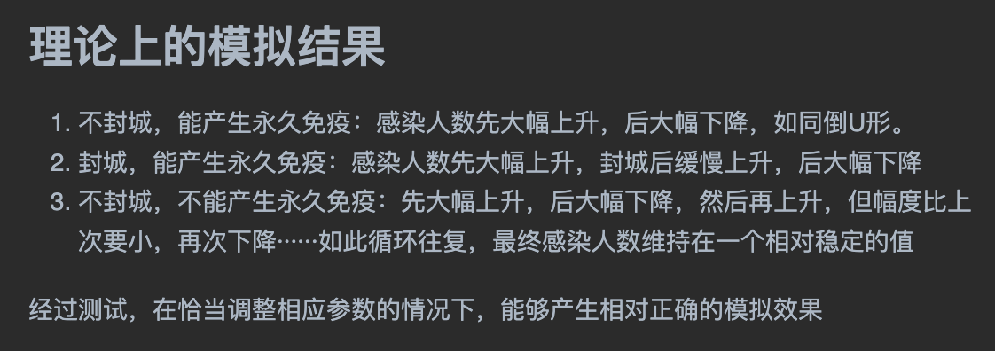

Slide 3
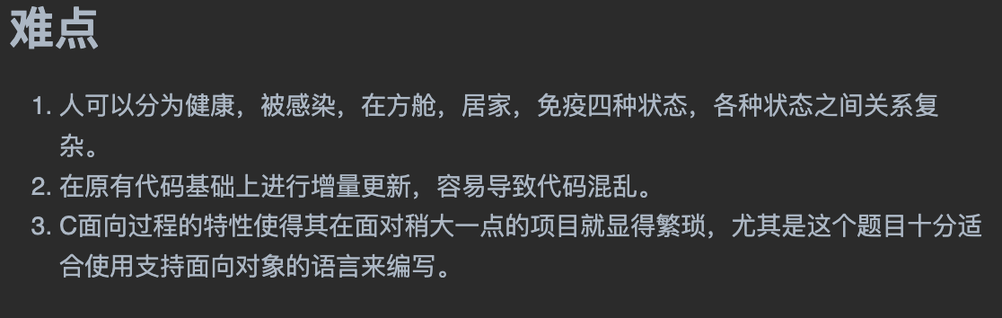

Slide 4
